Slide 1
Influencing Work Plan: 1st July 2017 to 30th June 2018

Slide 2
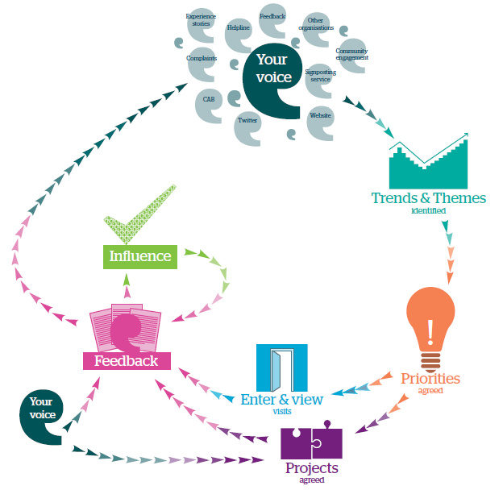
Influencing Work Plan 2017-18
What is influencing?
Having an effect on someone or something.
What does Healthwatch Surrey (HWSy) seek to affect?
The thoughts, behaviours, knowledge and action of commissioners, providers, practitioners and the public.

Slide 3
Influencing Work Plan 2017-18
In particular, what effect does HWSy seek to have?
An increase in:
Thoughts about people and the impact of services (commissioners/providers/practitioners)
Positive thoughts about the value of people being involved in decisions about their services (ALL)
Behaviours and action that enables increasing involvement of people in decisions about their services (ALL)
Knowledge about the experiences, views and needs of particular communities and topics (commissioners/providers/practitioners)
Action to investigate experiences of services to address poor practice / share good practice (commissioners/providers)

Slide 4
Influencing Work Plan 2017-18
> Principles
All HWSy activity that seeks to shape and challenge (AKA ‘influence’) local services will be guided by the following principles.
These principles will apply to the commitments within this plan, but also to activities undertaken when responding to and adapting to opportunities throughout the year. Activity that is:
Relationship enhancing
There are improved perceptions of credibility, trust and respect amongst commissioners, service providers, practitioners and the public.
Innovative
Activity has not been restricted to the established ways of working within Healthwatch Surrey and/or the health and social care landscape.
Solutions focused
The value of involving local people – directly and indirectly – in decisions about services has been demonstrated in our work. Relationships and consultation with commissioners, providers and practitioners has been a key enabler in achieving this.
Principles
Inclusive
Wider and more representative involvement of local people in decision making processes has been achieved as a result of our activity.
Respect plurality
Respect has been given to the fact that there will be numerous and differing personal views and experiences amongst people that access the same services. Whilst our activity seeks to be evidence-based and conclusive, we have never presented our views or evidence as representative of the people we serve.
Empowering
Leading by example; achieving things with and through the people and communities we serve; but also enabling people to achieve change for themselves e.g. providing information, advice and signposting related to opportunities for involvement in decision making

Slide 5
Influencing Work Plan 2017-18
> Methods
Some established methods of influencing will be used. These include:
What we’ve heard meetings
Providing challenge through the amplification of a selection of local voices in regular meetings with commissioners which leads to outcomes (assurance, acknowledgement, action) for local people and increased credibility of that voice.
Escalation of issues
Sharing emerging themes and individual experiences with commissioners, regulators, other organisations and the HWSy Escalation Panel which could lead to further investigation and action.
Participation in Boards
Making an independent, consumer-focused challenge and contribution in decision making fora; wherever possible providing insight into the lived experiences of those that are seldom heard.
Methods
Communications
Communicating to commissioners, providers and the public using HWSy media channels.
Facilitating involvement
Implementing projects that engage with people around specific topics which leads to findings and, wherever possible, conclusions and recommendations.

Slide 6
Influencing Work Plan 2017-18
> Thematic Cycle
Going forwards, once agreed upon by the Board, thematic priorities will run for a period of three years after which they will be reviewed and our impact in the area summarized;
Each year we will outline an aspiration attached to each theme, acting as the driver for our main projects;
We will plan a yearly programme of activity to contain one significant project attached to each theme, stating our desired project outcomes;
Aspirations and projects under each theme will be refreshed on a yearly basis in order to maintain flexibility within each theme depending on emerging evidence and insight;
We aim to have the programme of activity put in place each year by the end of January, ready to inform the yearly budget;
We will record project activity in terms of duration and outputs produced to help with the three year review and summary of work.

Slide 7
Influencing Work Plan 2017-18
> Thematic Priorities
The setting of thematic priorities provides an important focus for our work. These priorities have been informed by what people have reported to HWSy. Local people are also involved in this decision making process through our Priorities Recommendations Group which makes recommendations directly to our Board.
We have recently evaluated our priority setting process to ensure that a comprehensive and robust process is in place by Summer 2018. This includes merging what we’ve heard with external evidence, input from stakeholders and our HWSy volunteers. We will also be examining the LHM database for biases that may be present as a result of our priority focus and information gathering.
To enable HWSy to be reactive to issues arising in Surrey we have taken the decision to demote the NHS Complaints priority, leaving us with four priorities going forward in 2017/18.
What we are seeking, and the activity we are undertaking, around each of our thematic priorities for 2017-18 is documented below.
We will continue to communicate our work and what we have heard dynamically through reporting, attendance at meetings and our media strategy.

Slide 8
Amplify the Voices of Care Home Residents
Empowering the voice of Care Home residents
Background
Care home admissions are increasing in Surrey and are predicted to rise by 60% by 2030, putting extra pressure on homes. We have heard ongoing negative sentiment regarding residential care, and within this complaints regarding nutrition and hydration have been common. According to Age UK there are significant barriers for older people to express their views about their care.
The Issue
Elderly people in residential care in Surrey, and their families, should be given more opportunities to confidentially share their views about their care and the choices they are given, and have their voices amplified through appropriate channels.
Our aspiration:
Elderly residents in Surrey care homes (and their families) have a sustainable increase in opportunity to express their views and experiences to Healthwatch Surrey.
What we will do (and desired outcomes):
Conduct a survey of care providers to introduce HWSy, scoping out provider openness to further involvement with HWSy and receiving feedback from service users. Outcomes:
Indication of where to focus the Enter & View programme
Healthwatch Surrey materials displayed in more care homes for residents/families to access
Healthwatch Surrey are invited to attend care home open days/family days
A second Enter & View programme which focuses on person-centred care and nutrition – choice, respect, responsiveness – which leads to a report with conclusions and recommendations. Outcomes:
Positive response from decision makers & providers
Adoption of recommendations

Slide 9
Investigating the experience of Hospital Discharge
Investigating the experience of Hospital Discharge
Background
National research (Healthwatch England) identifies that people are experiencing a lack of co-ordination between different services at the point of leaving hospital, despite NHS England endorsing coordinated/integrated care as good practice. In ‘The Hospital Discharge Survey’ (HWSy in collaboration) over half of respondents reported having to repeat their medical history, and 15% reported that their discharge plan was not discussed with them and they were unsure what was going to happen next. We continue to hear about people’s concerns regarding discharge, particularly around poor communication and planning of the discharge process.
The Issue
People being discharged from hospital (and their relatives) would like better communication of their discharge plan and planned follow-up care.
Our aspiration: Following discharge, people in Surrey have a clear understanding of their care plan and feel confident about their follow-up care.
What we will do (and desired outcomes):
Investigate the views and experiences of people in Surrey regarding existing services using an integrated model of discharge, leading to a report with conclusions and recommendations. Outcomes:
Positive response from decision makers
Adoption of recommendations
Engage with people in a hospital setting to understand what is needed to ensure good communication and planning of care prior to discharge, leading to a checklist to empower people to guide their own discharge journey. Outcomes:
Use of checklist by patients and hospital staff
Service users report feeling empowered

Slide 10
Early Intervention in Mental Health
Shaping early intervention in Mental Health
Background
Adequate follow-up care and timely access to support following discharge from inpatient mental health care is key in promoting success during these first steps to recovery – unclear or abrupt discharge can discourage service users from accessing services in the future (NICE, CG136). Experiences of poorly communicated discharge and inconsistent follow-up care are evident in the recent HWSy ‘Keeping the Light On’ report.
For children there is particular frustration around the waiting times for Mindsight CAMHS and young people not receiving the treatment they need; these issues are recognized in the Surrey Child and Adolescent Mental Health Whole System Transformation Plan (Oct, 2016).
The Issue
Individuals experiencing mental ill-heath do not feel satisfied with the support they are receiving, particularly the timeline to accessing care, and how follow-up care is communicated on discharge from inpatient services.
Our aspirations:
People discharged from inpatient mental health care have the support and access to services that they need to stay well
Children and young people have timely and appropriate access to CAMHS
What we will do (and desired outcomes):
Undertake a specific project to find out more from people who have been discharged from inpatient services which leads to a report with conclusions and recommendations. Outcomes:
Positive response from decision makers
Adoption of recommendations
Give opportunity to young people in Surrey to voice their thoughts/concerns on accessing mental health services (this will be flexible dependent on conversations with commissioners and VCFS organisations regarding what is already being done)

Slide 11
Improving the experience of making a GP appointment
Improving the experience of making GP appointments
Background
We know from commissioner feedback and what we’ve heard that the uptake of online booking for GP services is still low (HWSy, IPSOS Mori). The recent ‘My GP Journey Report’ also suggests that accessing GPs is particularly difficult for individuals with communication difficulties and there is a need for better staff awareness of these issues, despite the Accessible Information Standard and obligations under the Equality Act (2010).
The Issue
Uptake of online GP services is low and individuals with communication difficulties find it particularly hard to access GP services.
Our aspiration:
People in Surrey are able to use a variety of methods to access GP services, including those who experience barriers to communication.
What we will do (and desired outcomes):
Collaborate with the Good Things Foundation charity to promote online GP services during Surrey ‘Get Online’ week and understand the barriers associated with online appointment booking. Outcomes:
Positive feedback from participants & increased awareness of online booking
Acknowledgement of barriers to using online services
Survey GP surgeries’ and PPGs’ need for support in understanding and overcoming condition-related communication barriers and offer support to access the relevant VCFS groups/information. Outcomes:
Increased awareness of communication needs by practice staff and PPGs
Uptake of additional information by GP surgeries

Slide 12
Influencing Work Plan 2017-18
Vision
Healthwatch Surrey is the respected, trusted and credible champion of the consumer for health and social care in Surrey. Our role, function and services are known, understood and valued by consumers and therefore they readily contact us. Our influencing is based on sound evidence, knowledge and insight. As a social enterprise we have secured a growing and sustainable future.
Amplify the voice of Care Home residents
Investigating the experience of Hospital Discharge
Shaping early intervention in Mental Health
Improving the experience of making a GP appointment
Reactive Projects
Priorities
Our aspiration:
Elderly residents in Surrey care homes (and their families) have a sustainable increase in opportunity to express their views and experiences to Healthwatch Surrey.
Our aspiration: Following discharge, people in Surrey have a clear understanding of their care plan and feel confident about their follow-up care.
Our aspirations:
People discharged from inpatient mental health care have the support and access to services that they need to stay well.
Children and young people have timely and appropriate access to CAMHS.
Our aspiration:
People in Surrey are able to use a variety of methods to access GP services, including those who experience barriers to communication.
Our aspiration: HWSy invests appropriate resources into flexible and reactive projects
INFLUENCE
Our aspirations
OUTCOMES
Empowering
Respects Plurality
Inclusive
Solutions focused
Innovative
Relationship enhancing
Principles & Methods
Facilitating involvement
Communications
Participation in Boards
Escalation of issues
What we’ve heard meetings
HWSy Work plan
Build relationships
Raise awareness
Increase evidence
Find voices
Thematic priorities
Emerging issues
Empowering volunteers
Improve sustainability
Review structure
Values
Tenacious
Adaptable
Creative
Compassionate

